Slide 1
China Under Mongol Rule
Chapter 12

Slide 2
Mongol Conquest of the Jin and Xia Dynasties
Mongol tactic: plunder and withdraw
Jin negotiates peace with Chinggis
Movement of capital viewed as revolt
Chinggis sacks capital in 1215
Jin succumbs to Mongols by 1234
Multiethnic: Chinggis absorbs Chinese and Khitan in his armies
Yelu Qucai
Chinggis dies during attack on Tangut Xia
Notes:
Yelü Chucai, orYeh-lü Ch’u-ts’ai, (born 1190—died 1244), Chinese statesman of Khitanextraction, adviser to Genghis Khan and his son Ögödei. He established a formal bureaucracyand rationalized taxation system for the Mongol-controlled portions of China. By persuading Ögödei to spare the inhabitants of northern China in order to utilize their wealth and skills, Yelü gave the Mongols access to the Chinese weapons that later enabled them to conquer the Song dynasty.

Slide 3
Mongol Conquest of Korea
Mongols demand tribute from Koryo; Choe I fails to respond
Mongol forces invade in 1231
Koryo sues for peace; disbands army; send hostages to Mongolia
Mongol forces invade again when resident commissioners killed; Court takes refuge on Kanghwa Island for 20 years
Buddhist Tripitika carved to gain aid of cosmic Buddha against the Mongols
Notes:
Skip for HIST 270

Slide 4
Court refuses to leave Island as Mongols destroy the peninsula
Military rule in Korea ends as Choe generals are assassinated; Court continues to reside on Kanghwa
Sends crown prince to Mongolia as hostage
Mongol domination and “Mongolization” of Korean Court
Notes:
Skip for HIST 270

Slide 5
MONGOL CONQUEST OF SOUTHERN SONG
Notes:
Song knew of Mongol conquest. Refugees brought horror stories. To prepare, chancellor confiscated lands of the rich – disaffecting that population. Mongol conquest did not come when expected in the 1240s and 1250s – they were busy extending control into Central Asia. Gave more time to Song to prepare and Mongols to learn how to deal with China

Slide 6
Khubilai
Grandson to Ghinggis
Advised by Liu Bingzhong (Chinese)
Learned that repeated plundering of North China reduced its worth
Assigned Control of North China
Used Chinese style government
Led campaign in Yunnan; defeated state of Dali
(1259) Mongke died during campaign against the Song; succession dispute between Khubilai and his brother
Notes:
Möngke (Grandson to Chinggis, January 11, 1209 – August 11, 1259) was the fourth khagan of the Mongol Empire, ruling from July 1, 1251, to August 11, 1259. He was the first Khagan from the Toluid line, and made significant reforms to improve the administration of the Empire during his reign. Under Möngke, the Mongols conquered Iraq and Syria as well as the kingdom of Dali.[2]

Slide 7
Yuan Dynasty
Khubilai moves capital to Dadu (modern Beijing)
(1271) Proclaims the Yuan dynasty
Ruled as traditional Chinese Emperor
Court ceremonials
Schools and examinations
Six ministries
Added a new higher level of government

Slide 8
Crossing the Yangzi River
Non-Chinese groups unable to rule south of the Yangzi
Calvary ineffective because of streams and canals
Mongols begin constructing fleet based on Chinese advisors
(1268) Mongols set siege to Xiangyang with multi-ethnic state
Mongol General Bayan leads invasion south with mainly Chinese army
Mongols greatest threat Chinese civilization ever faced

Slide 9
Collapse of the Song
Song unprepared to deal with Mongol onslaught
Ineffective emperor (Child on the throne)
Advisors to dowager bickered among themselves
Dowager calls on the people to rise up against the Mongols
Mongol scare tactics – total slaughter
Song surrenders; a few loyalist continue the fight

Slide 10
LIFE IN CHINA UNDER THE MONGOLS
Notes:
10

Slide 11
Social Status
Mongols decreased social mobility; placed people in hereditary occupation categories
Provided unpaid service on rotation schedule
Four-fold status – keep Chinese from gaining dominant position
Mongols
Special Status – Mongol Allies, i.e., Central Asia tribes
Hanren (Han People) – North Chinese, Koreans, Jurchen
Nanren (South People) – Southern Song Chinese (Manzi, southern barbarians)
Preserving Mongol Privileges as Conquerors
Preventing Chinese rebellion
Notes:
Occupation categories: farmer, confucian scholar, physician, astrologer, soldier, artisan, salt producer, miner, monk, other.
Preserving Mongol privileges as conquerors: Chinese not allowed to take Mongol names, intermarriage discouraged,
Preventing Chinese rebellion: forbidden to own weapons or congregate in public; chinese prohibited from dealing in bamboo as bamboo used to make bow and arrows

Slide 12
Economy
Attempt to maintain strong economy
Encouraged foreign trade
Maintained paper currency
Downward spiral
Production impeded by scattering of population
Tax farming
Inflation
Mongol infighting and incompetent emperors
Calamitous 14th century

Slide 13
Chinese Educated Elite During the Mongol Era
Cosmopolitan nature of Mongol government
Fewer government positions open to educated Chinese
Mongols employed Chinese clerks
Reinstituted civil service exam
Quotas limited number of Chinese passers
Literati found other ways to support themselves
Leadership roles at local level
Asserted civil over military values and saw themselves as trustees of Confucian tradition
Notes:
Other ways to support themselves: live off income from land, work as physicians, fortune-tellers, teachers,; took on leadership roles at the local level – founding academies of Confucian learning, organizing kinship into lineages, promoting local charitable ventures.

Slide 14
The Mongol Invasions
1274 & 1281

Slide 15
Khubilai Khan’s Lost Fleet
Unearthing Ancient Secrets
Notes:
In My Amazon Video Library
Show from 1:21 – 5:40 as lecture opener

Slide 16
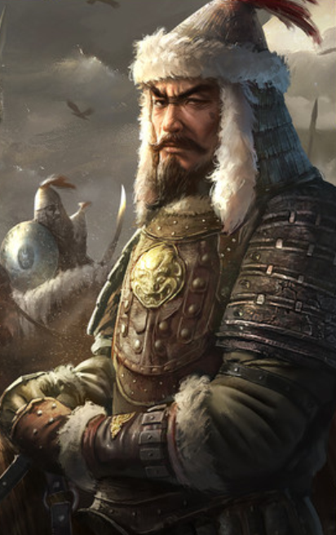
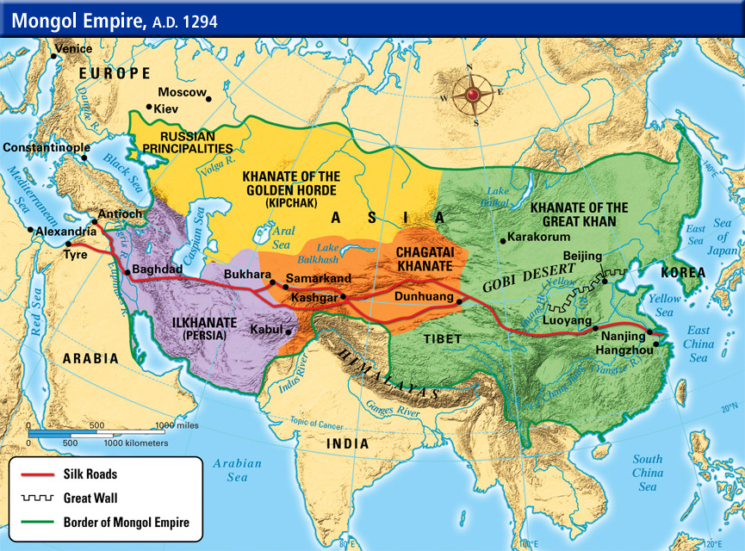
Rise of Mongol Empire;

Slide 17
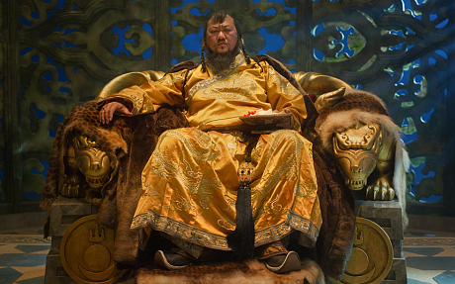
The Mongol Invasions
Kublai Khan expands into Korean Peninsula
Kublai sends envoys to Japan demanding submission;
Letters forwarded to court
Envoys expelled without answer; tantamount to a declaration of war

Slide 18
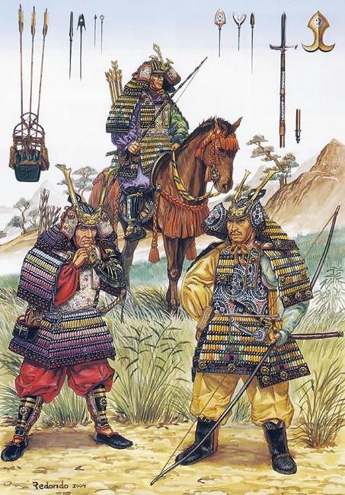
The Mongol Invasions
Governors of West ordered to shore up defenses
Samurai of western and central provinces ordered to move west to aid in defense
Court and clerics begin praying for safety of realm

Slide 19
First Mongol Invasion, 1274
Kublai ordered King of Korea to build warships and raise an army
Invasion force consisted of 15,000 Mongol and Chinese troops, 8,000 Korean troops and 7,000 Korean sailors
Fleet composed of 300 large vessels and 400 smaller craft
Tsushima and Iki islands captured without much difficulty

Slide 20
First Mongol Invasion, 1274
Then proceeded to Hakata Bay; Samurai ordered to hasten to Hakata
Mongols attacked the next day, with advantage over Japanese
Battle seasoned trained in close formation vs. single hand to hand combat
No Japanese general with experience with large army in field
Mongols had advantage in weapons – long range cross bows and engines for throwing missiles and bombs
By nightfall rain started to fall, Korean sailors convinced Mongols to re-embark
During the night typhoon sank most of the fleet killing apx 13,000 men

Slide 21
Second Mongol Invasion, 1281
Japanese immediately shore up defenses
Construction of stone wall to hinder landing and take up position in formation
Mongol envoys executed
Launched an enormous armada
900 ships carrying 40,000 Mongol and Korean soldiers
3,500 ships carrying 100,000 defeated Chinese soldiers

Slide 22
Second Mongol Invasion, 1281
Japanese defense was strong and effective
Korean and Chinese soldiers had no reason to be loyal
Evidence of sabotage
Typhoon defeated Mongols again; known as kamikaze (divine winds)
Majority of force drowned at sea or were killed by Japanese warriors

